Slide 1

Project: Scheduler
BY: Tim Li, Alex Melnbardis, and bob ZhEng

Slide 2
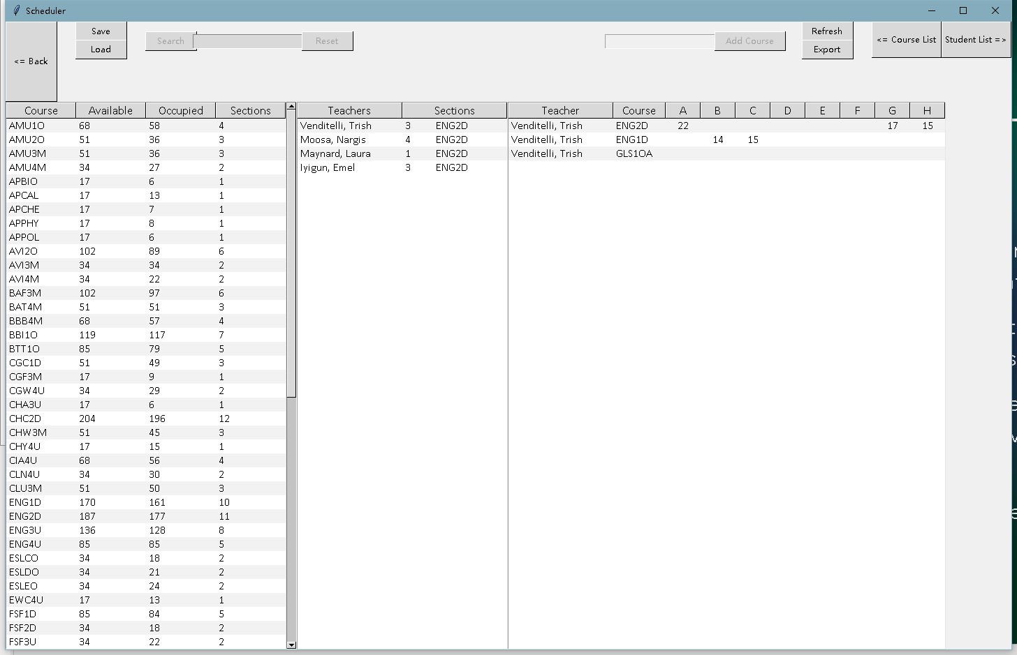
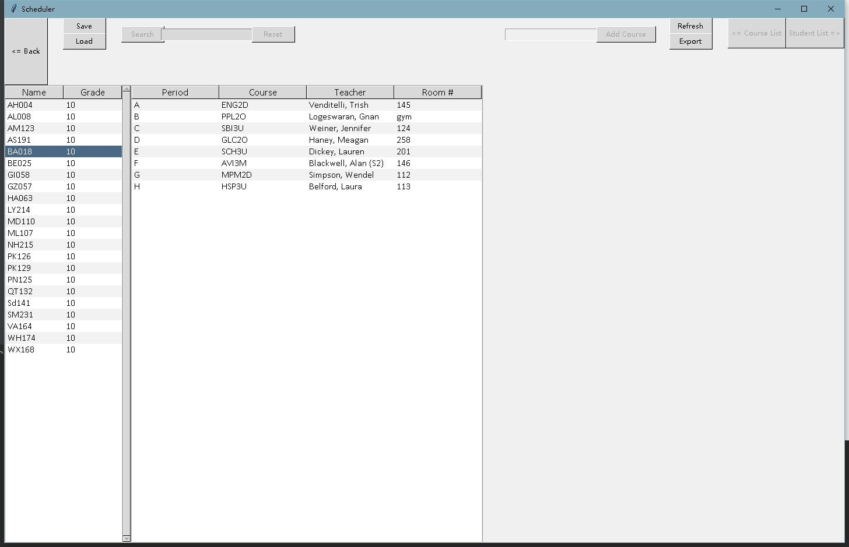
What Is a Scheduler?
A program that organizes a school's timetables and information
Creates student/teacher schedules, manages courses, etc.
Schedules are created through randomization, availability, and requirements
Program structure is very complex

Slide 3
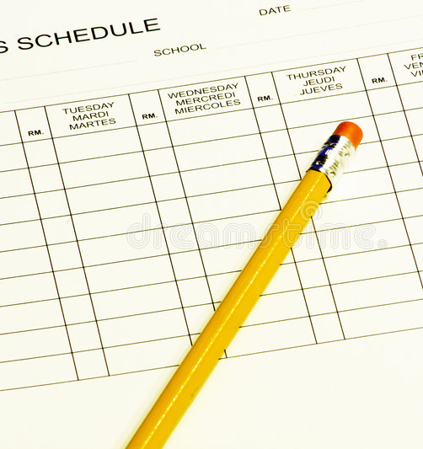
Project Scope
Read given files
Generate schedules
Display interactive data
Allow manual input
Save and output

Slide 4

Programming Language and Modules
Python:
Pandas (read files)
Tkinter (make GUI)
Pickle (save & load data)
Csv (export as csv file)

Slide 5

Our Planning Process
Make files readable
Read all info, and store it in a nested dictionary
Make the frame of the GUI
Process data to generate schedules
Insert data to the GUI
Implement different features
Test the program

Slide 6

Our Logic on Creating Schedules
Data we have: students' names, grades, and course selections, as well as room numbers and courses for each teacher
Assign teachers to each section
Assign periods to each section
Assign rooms to each section
Add students to each section

Slide 7
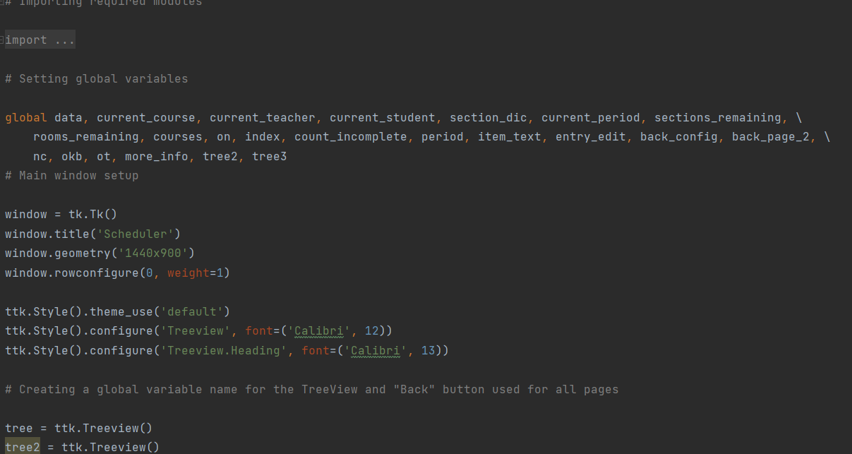
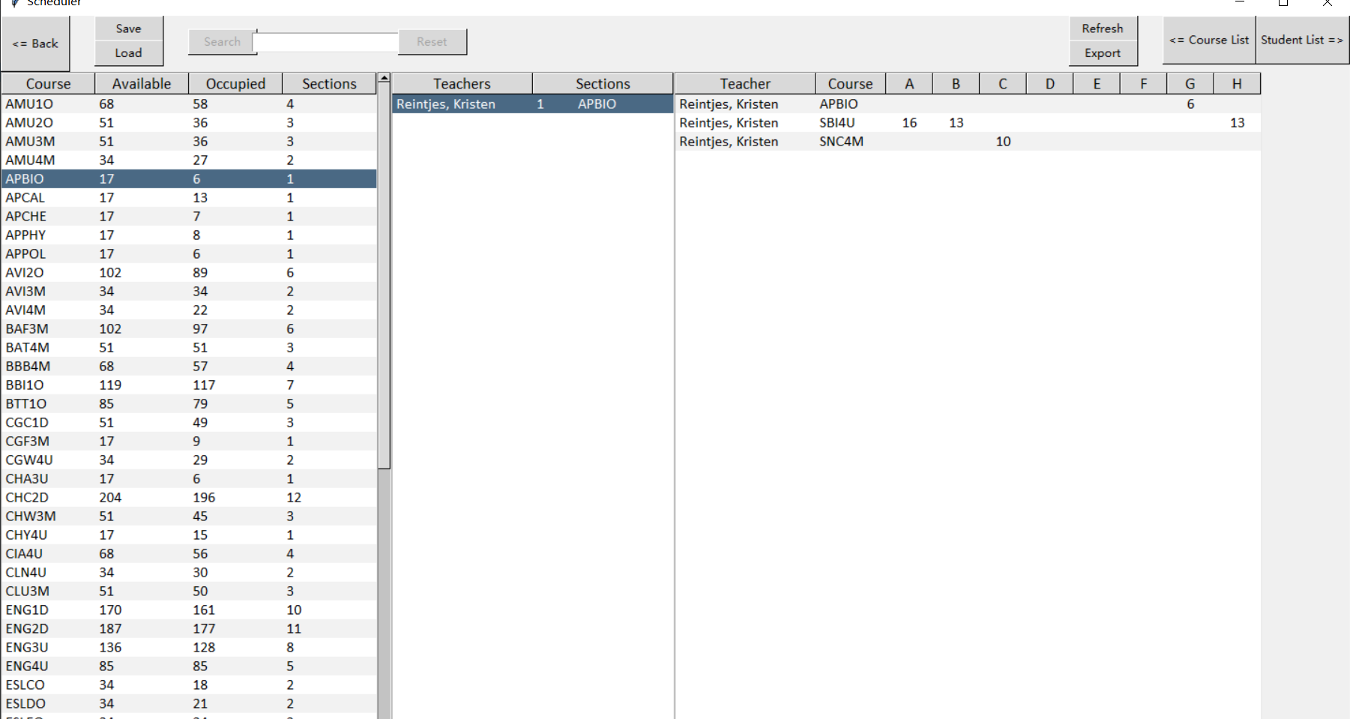
Our Code & Program

Slide 8
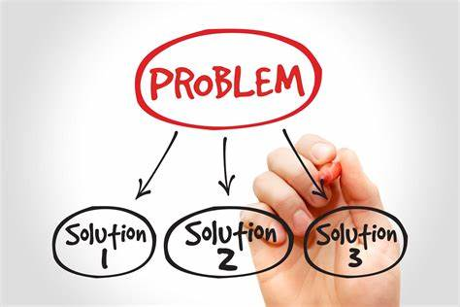
Teamwork on Problem-Solving: Structure
We followed a set structure when solving problems
1. Identify the problem's severity
2. Individually create unique solutions
3. Check solutions among ourselves
4. Repeat process or work to together to integrate all solutions

Slide 9

Teamwork on Problem-Solving: Biggest problem we encountered
“Adding students to sections”
Very urgent that we couldn't move on without solving it
Everyone provided their own solution to avoid putting all the eggs in one basket
Compare and contrast each solution
We solved it!

Slide 10

Teamwork on Problem-Solving: "What Did We Learn?"
Expect the unexpected
Be Creative
Work hard!!!
Be grateful to teammates

